Slide 1

Adult Income Dataset
Rehan Khan

Slide 2




Agenda
Overview
Dataset Features
Conclusions

Slide 3



Introduction
The adult income dataset displays an individual’s annual income results from various factors. Intuitively, it is influenced by the individual’s education level, age, gender, occupation.

Slide 4

Dataset Features

Slide 5
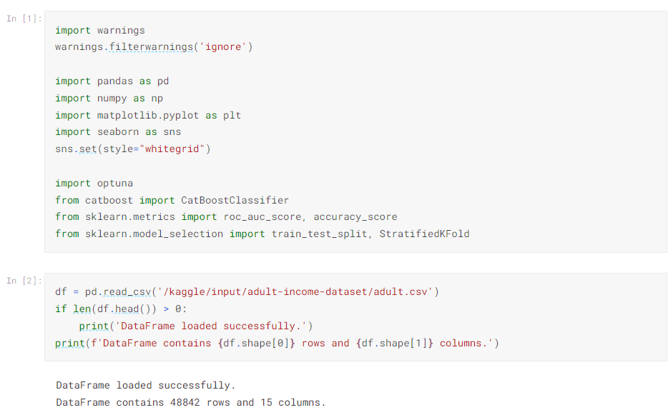
Summary of Columns

Slide 6
Adult Income

Slide 7
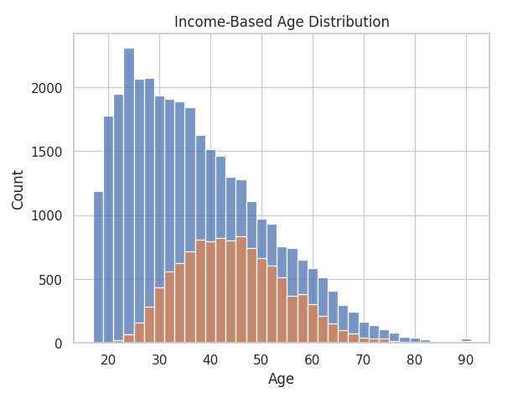

The Role of Age on Income

Slide 8
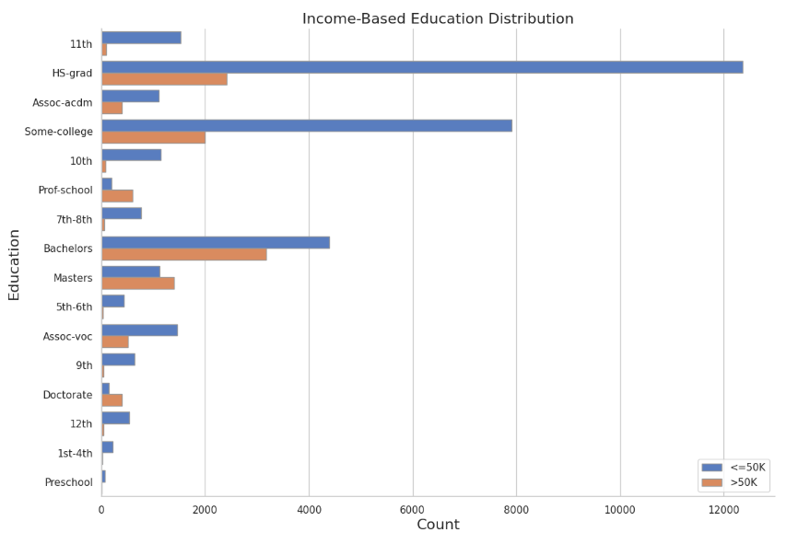
The Role of Education on Income

Slide 9




Conclusions
Age and education are the biggest factors that affect overall income in Adults.

Slide 10

Thank You
Rehan Khan

